Slide 1
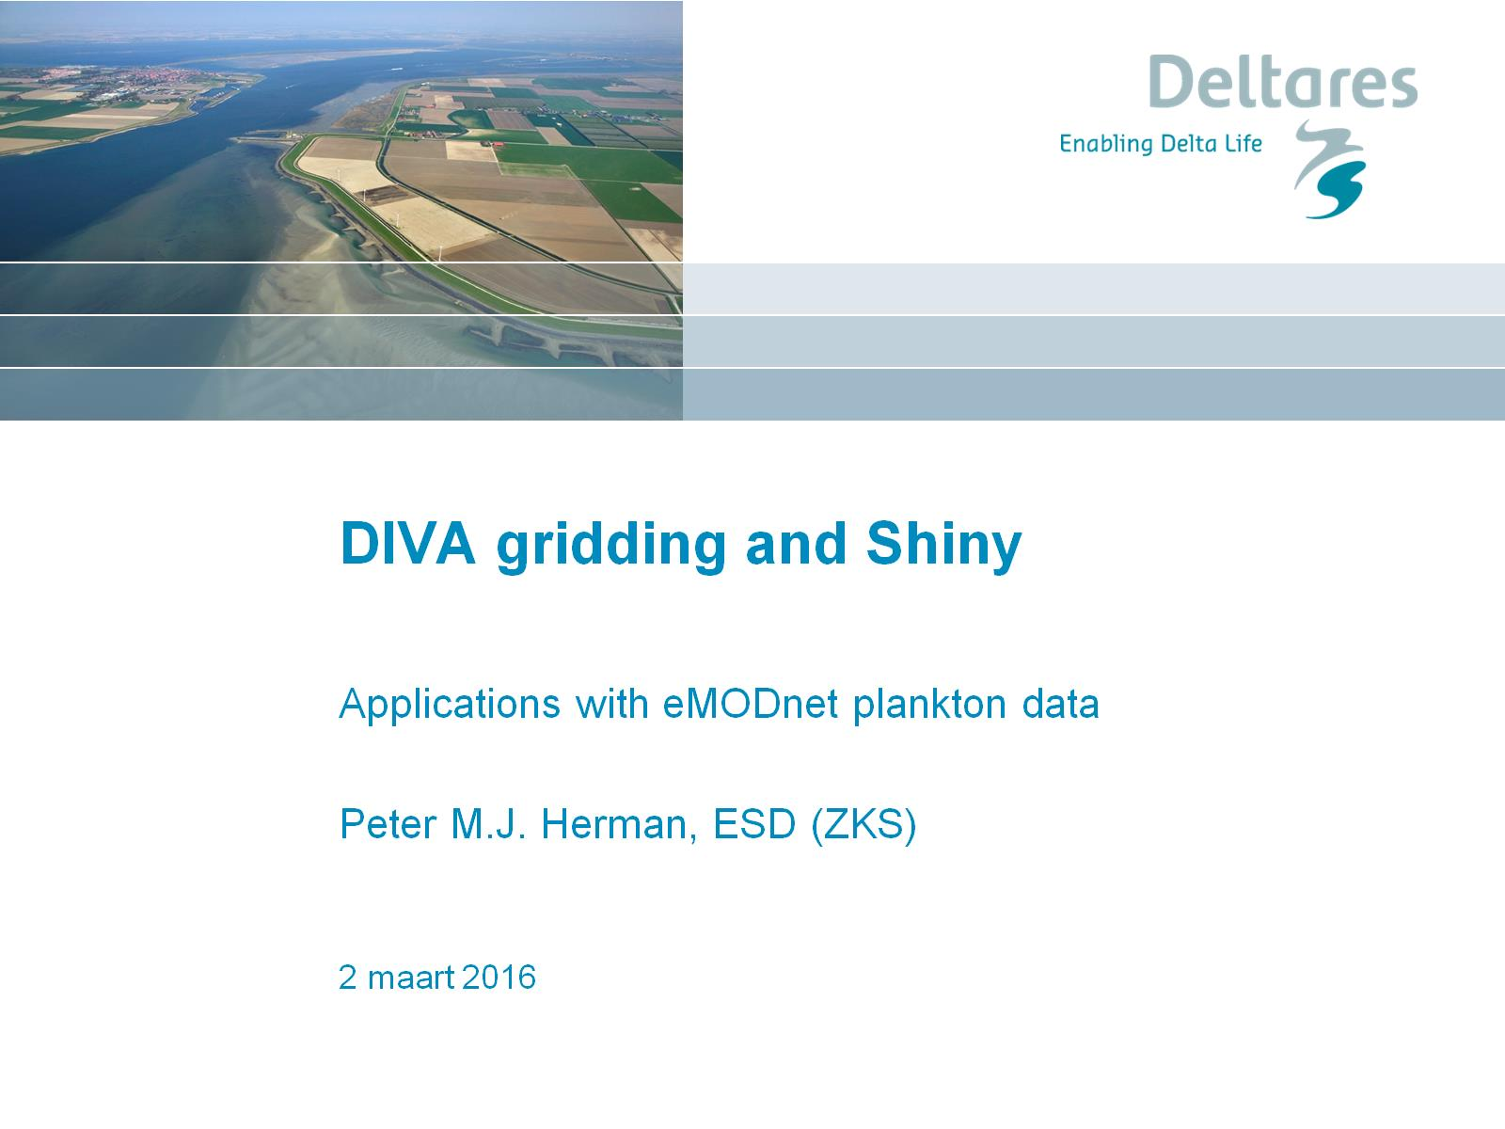
DIVA gridding and Shiny

Slide 2
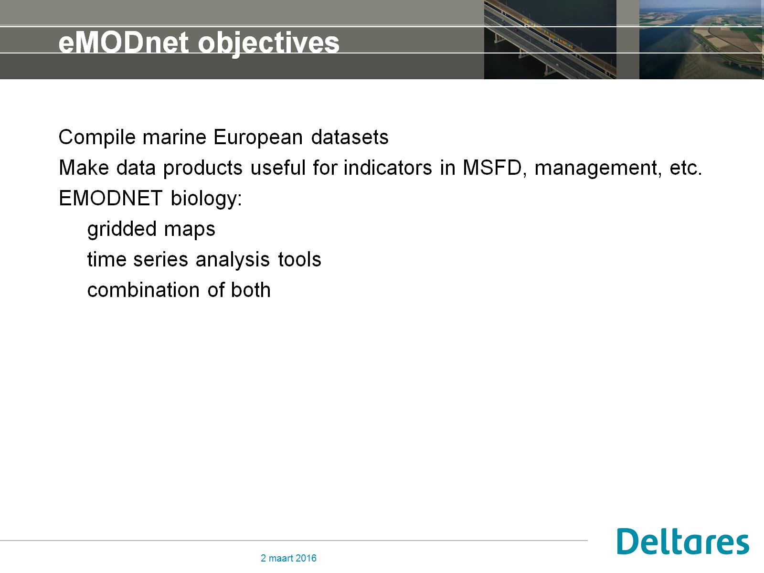
eMODnet objectives

Slide 3
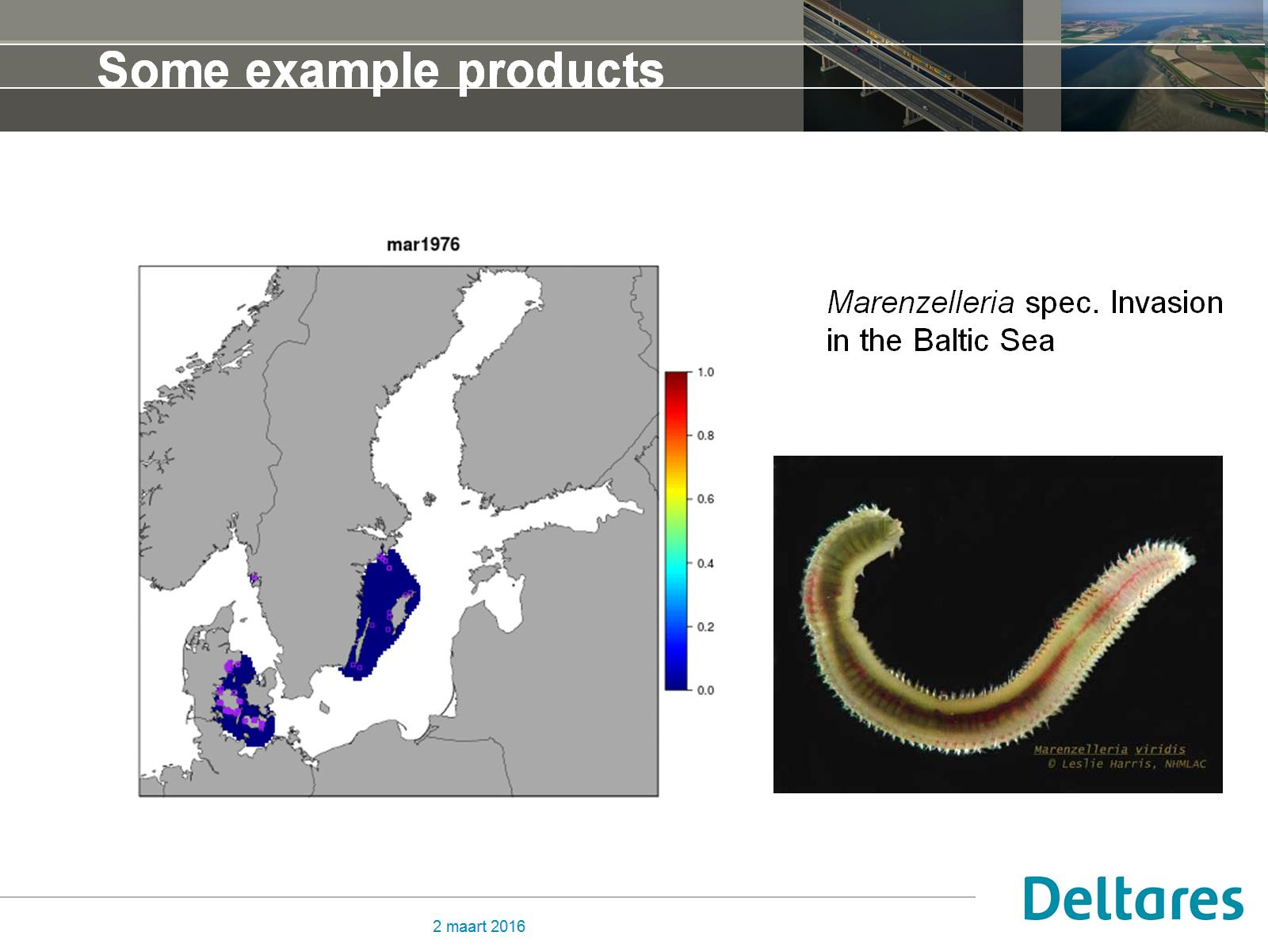
Some example products

Slide 4
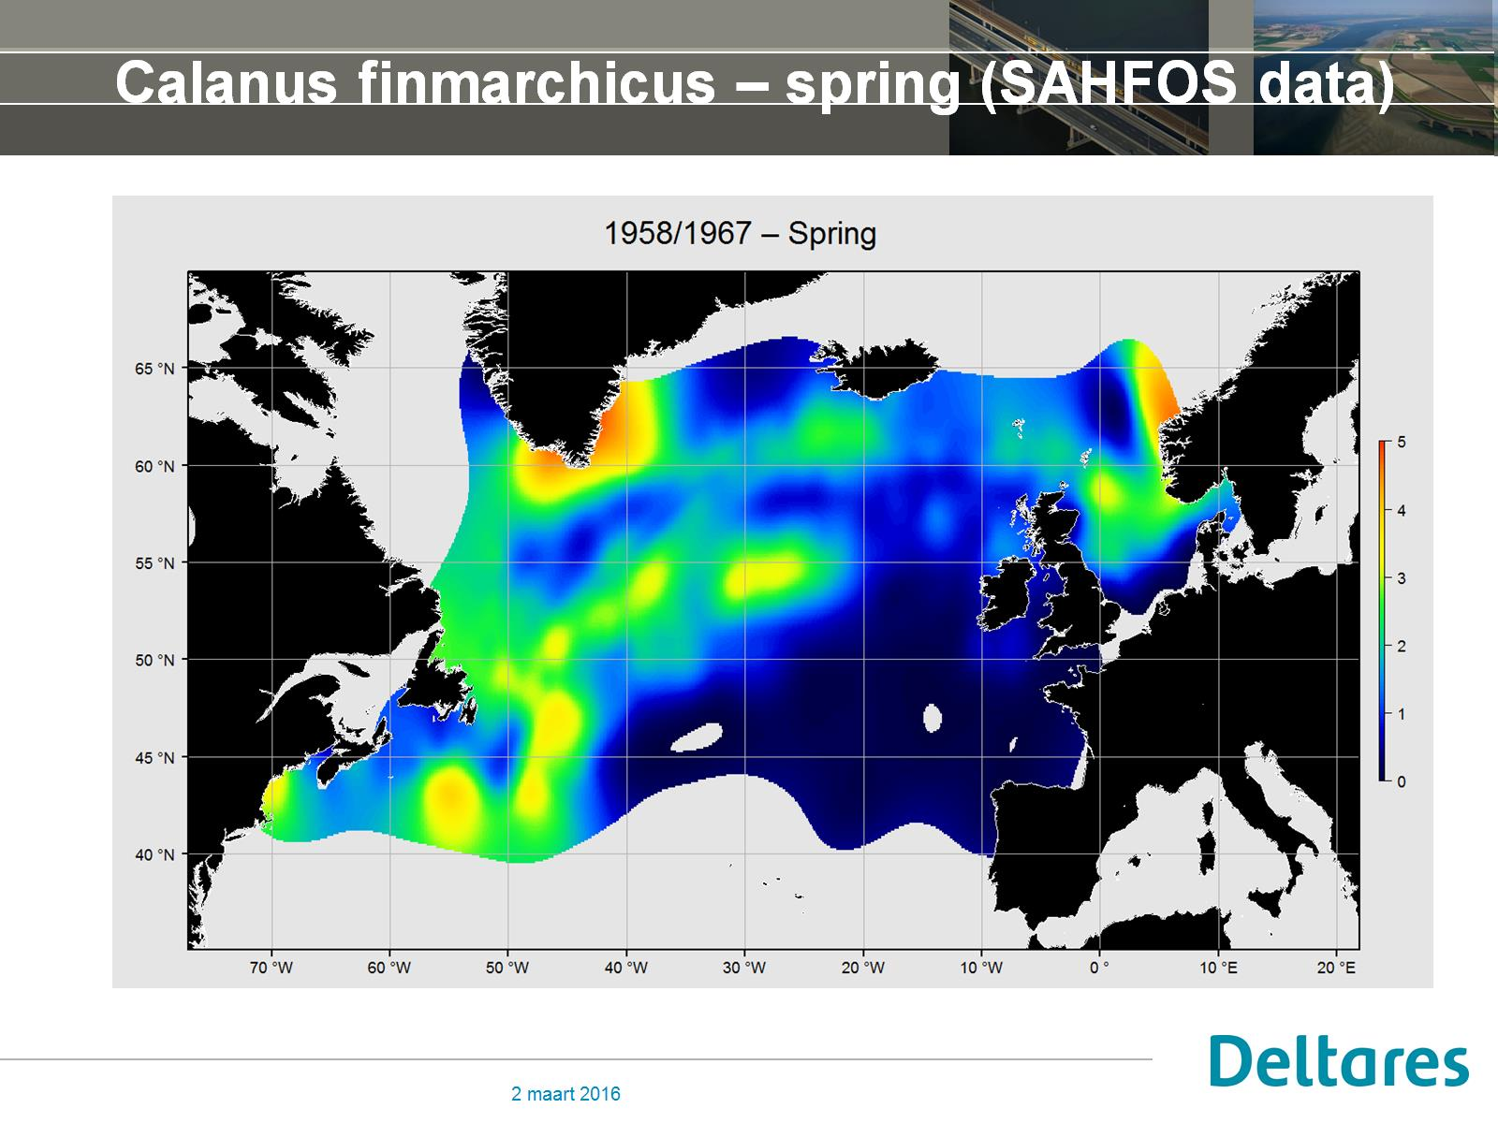
Calanus finmarchicus – spring (SAHFOS data)

Slide 5
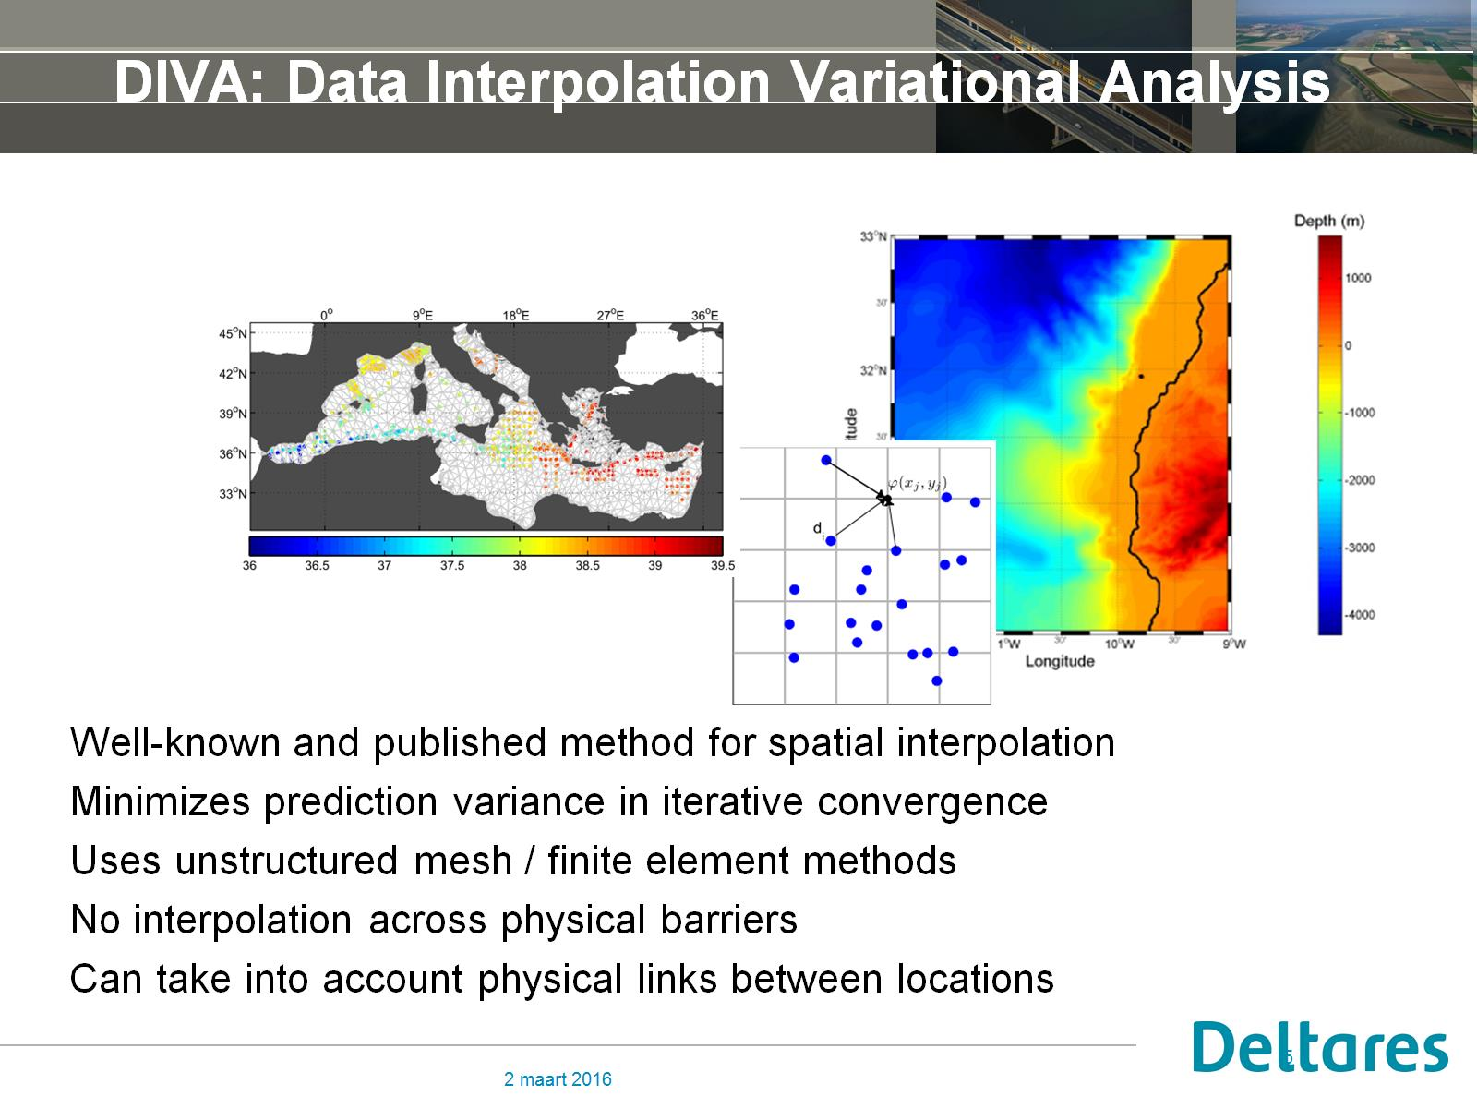
DIVA: Data Interpolation Variational Analysis

Slide 6
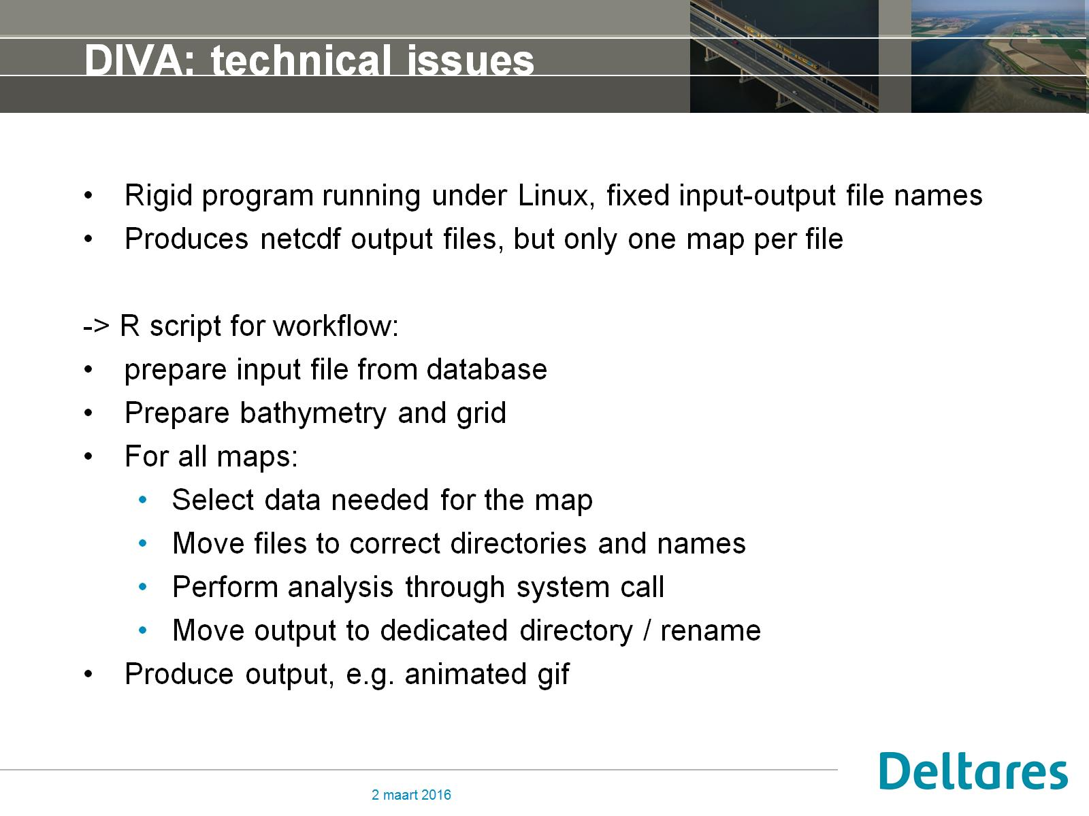
DIVA: technical issues

Slide 7
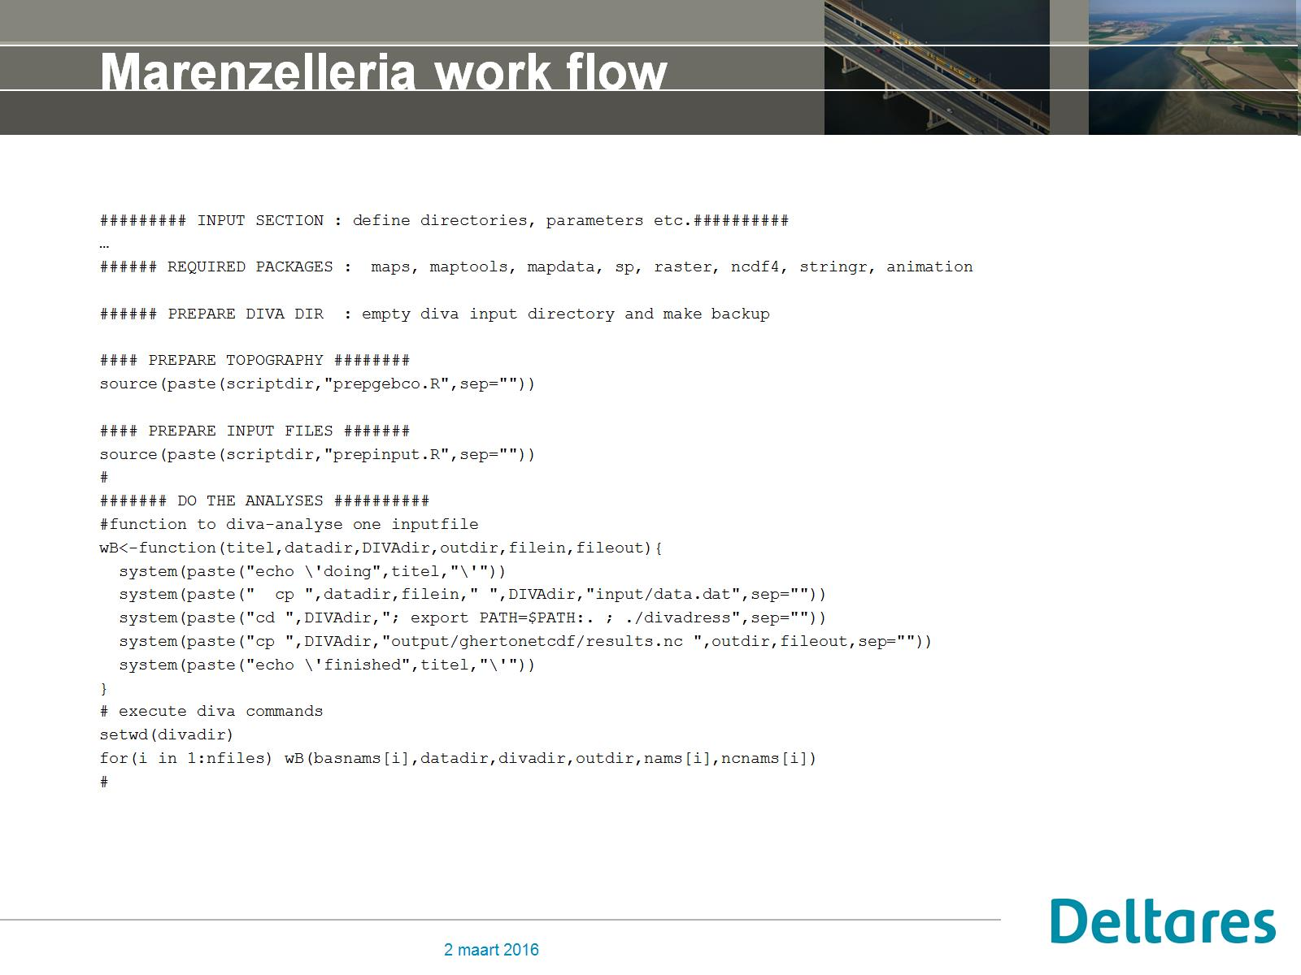
Marenzelleria work flow

Slide 8
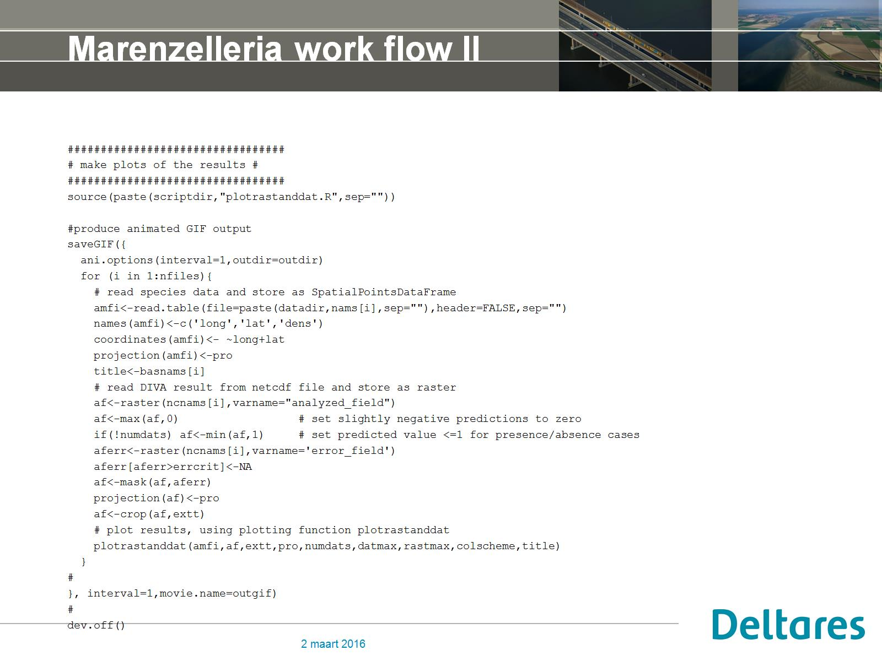
Marenzelleria work flow II

Slide 9
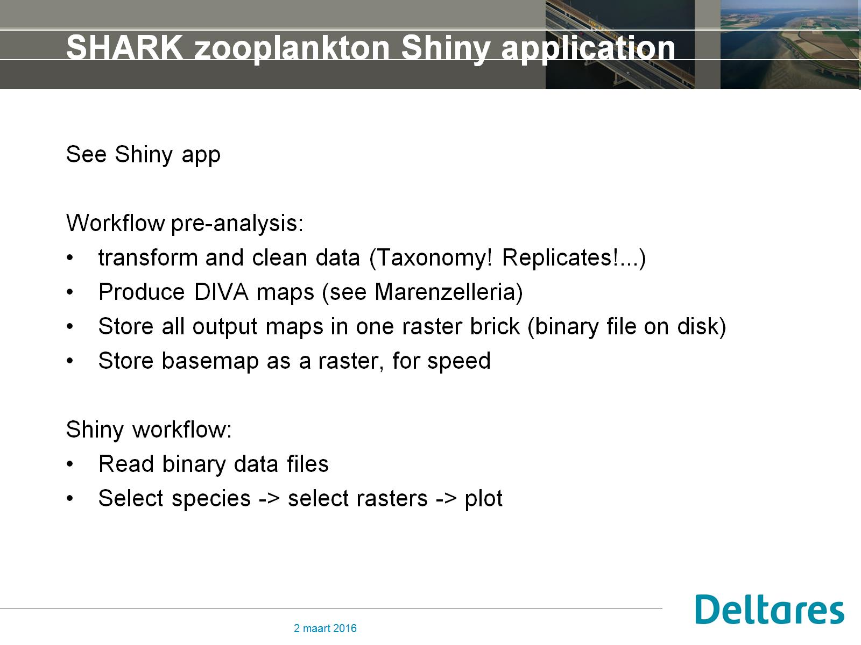
SHARK zooplankton Shiny application

Slide 10
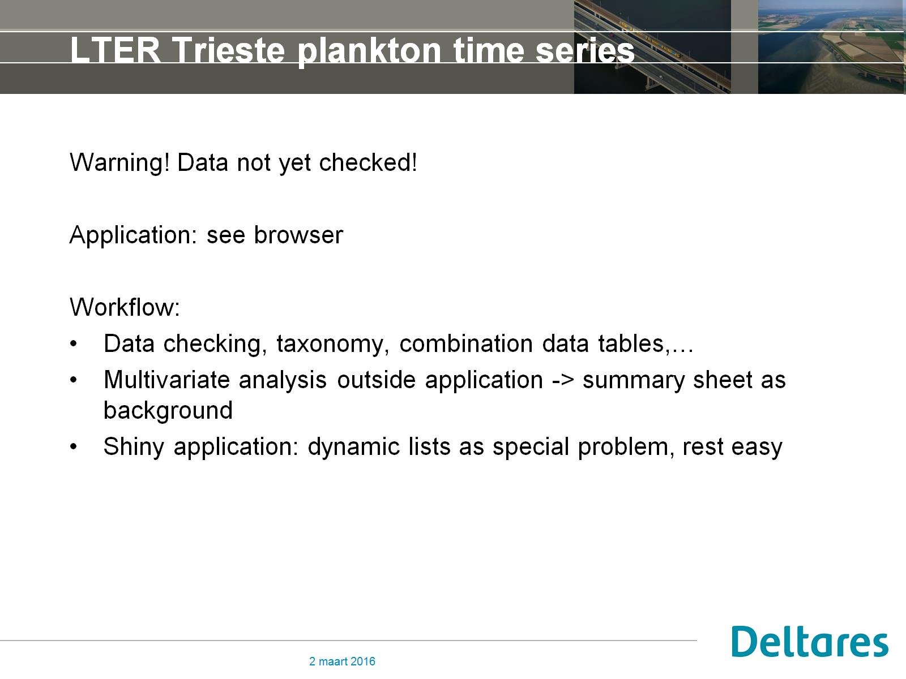
LTER Trieste plankton time series

